Slide 1
Top-Down Parsing Using High Level Language(C)
By:
B. Revanth Harsha Vardhan(192210076)
K. Someshwar Reddy(192210045)
N. Manoj Reddy(192210044)

Slide 2
Introduction to Top-Down Parsing:
Top-down parsing is a fundamental technique used in compiler design, where the parser starts with the root of the parse tree and recursively builds the tree by analyzing the input from left to right.
This approach provides a clear understanding of the structure of the source code.
Top-down parsing is often referred to as predictive parsing because it predicts which production to use based on the current non-terminal and the next input symbol .
Top-down parsers typically use a parsing table that maps each pair of to the corresponding production or action.
Grammar must be analyzed for left recursion and common prefixes to ensure suitability for LL parsing.

Slide 3
Context of Compiler Design:
1
Lexical Analysis
Breaks the input text into a sequence of tokens.
2
Parsing
Analyzes the token sequence to determine the grammatical structure of the program.
3
Semantic Analysis
Checks the program for semantic correctness based on the language's rules.

Slide 4
Characteristics of Top-Down Parsing:
1
Predictive
2
Recursive
Top-down parsers make decisions based on the current input symbol and the current state of the parser.
The parsing process involves recursively breaking down the input into smaller parts until the base case is reached.
3
Backtracking
Top-down parsers may need to backtrack if the initial parsing decision proves to be incorrect.

Slide 5
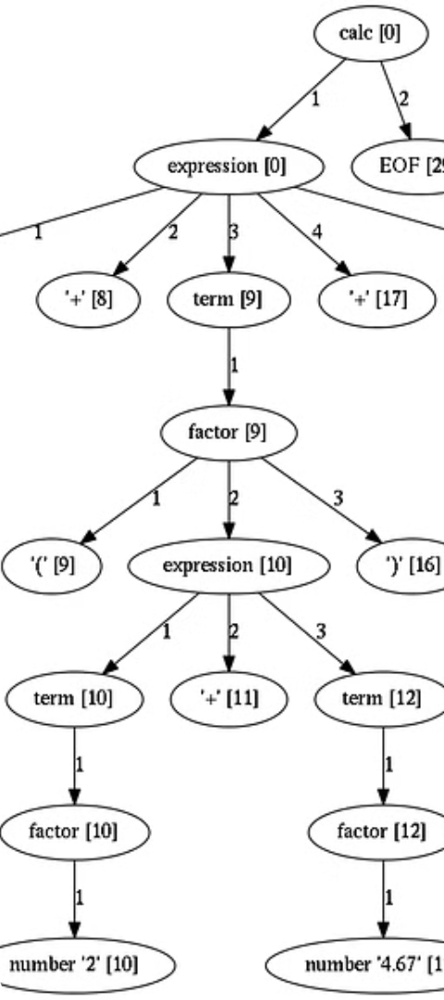
Constructing Parse Trees:
1
Top-down Approach
The parser starts with the root of the parse tree and recursively expands non-terminals into their production rules.
2
Bottom-up Approach
The parser starts with the leaves of the parse tree and recursively combines terminals and non-terminals into larger constructs.

Slide 6



Advantages and Limitations of Top-Down Parsing:
Efficient
Limited by Grammar
Top-down parsers can often find a parse in a single left-to-right scan of the input.
Top-down parsers require the grammar to be LL(1) compliant, which can be restrictive.
Fast Parsing
Top-down parsing is generally faster than bottom-up parsing for certain classes of grammars.

Slide 7
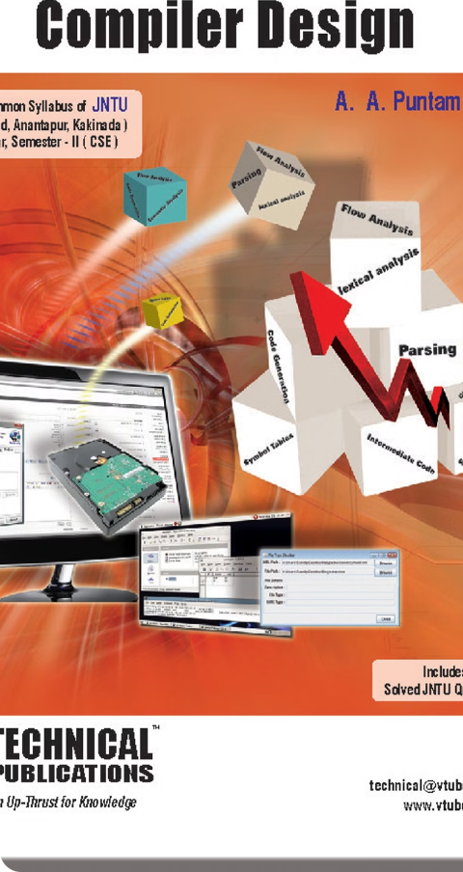



Conclusion and Future Considerations
Ongoing Research
Researchers continue to explore ways to extend the power and flexibility of top-down parsing techniques.
Optimizations
Efforts are being made to improve the efficiency and accuracy of top-down parsing algorithms.
Hybrid Approaches
Combining top-down and bottom-up parsing strategies can lead to more robust and versatile parsing systems.

Slide 8
THANK YOU

